Slide 1




My SQL Capstone Project
A deep dive into songs dataset

Slide 2


project overview
I delved into a songs dataset using MySQL, crafting a comprehensive database comprising tables for albums and bands. After populating these tables, I embarked on detailed analysis, unraveling insights crucial for decision-making. Utilizing SQL queries, I tackled various problem statements, use of orderby, group by, joins, wildcards, etc , refining my problem-solving skills. This project not only honed my MySQL proficiency but also sharpened my analytical acumen, providing invaluable hands-on experience in database management and analysis.
www.reallygreatsite.com

Slide 3




Tools and methodology
Using MySQL Workbench, I adeptly managed the database, ensuring seamless execution of tasks. Employing a structured methodology, I initiated with database creation and meticulous table design. I meticulously inserted data, laying a solid groundwork for analysis. Leveraging SQL queries, order by, group by, joins, wildcards, I addressed intricate problem statements, honing my problem-solving prowess. This systematic approach facilitated a holistic comprehension of database management and analysis, culminating
in a successful MySQL capstone project

Slide 4


Problem Statements
Problem 1 : Select only the names of all Bands from the songs table
Problem 2: Select the oldest album.
Problem 3 : Get all the bands that have albums
Problem 4 : Get all the bands that have no albums
Problem 5: Get the longest album
Problem 6 : Get the Average length of all songs
Problem 7 : Filter the Albums which start with the word 'The'
Problem 8: Find the album which released in 2008 to 2013.
www.reallygreatsite.com

Slide 5



Problem 1 : Select only the names of all Bands from the songs table
Query:
www.reallygreatsite.com

Slide 6

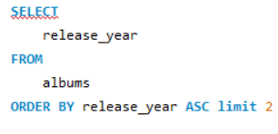
Problem 2: Select the oldest album.
Query:-
Result :- 1988
www.reallygreatsite.com

Slide 7
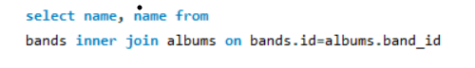
Problem 3 : Get all the bands that have albums
Query:-
www.reallygreatsite.com

Slide 8
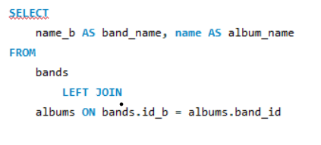
Problem 4 : Get all the bands that have no albums
Query:-
Result:- dream theatre has no album
www.reallygreatsite.com

Slide 9
Get the longest album
Problem 5 :
Query:-
Result:- death magnetic is the longest album.
www.reallygreatsite.com

Slide 10
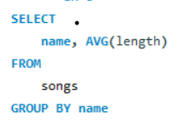
Problem 6 : Get the Average length of all songs
Query:-
www.reallygreatsite.com

Slide 11
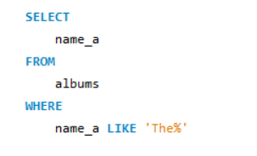
Problem 7 : Filter the Albums which start with the word 'The'
Query:-
Result :-
The Great Escape
The Unforgiving
The Sound of Perseverance
www.reallygreatsite.com

Slide 12

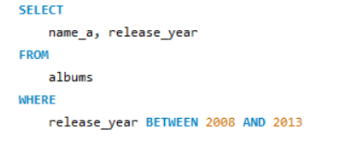
Problem 8: Find the album which released in 2008 to 2013.
Query:-
www.reallygreatsite.com

Slide 13


Thank
You
Mohd Amish
-Seeking opportunities as a data analyst
+91 7526061108
siddiquiamish62@gmail.com
www.reallygreatsite.com

